Slide 1






SSB – MuleSoft Implementation C4E Discussion Meeting
Updated: April 14, 2021

Slide 2
Center for Enablement - Key Functions
The C4E is focused on running the API platform, enabling teams on how to best use the platform and develop reusable APIs to deliver change more efficiently and accelerate innovation.
C4E Governance
Platform
Enablement
Platform Monitoring & Support
Platform & API Monitoring
Platform Management
Operation Support
Reference
Architecture
API Best
Practices
Platform Architecture
Training and Certification
Security Architecture
Domain, Process/Controls, and Tool Usage Playbook(s)
Integration Architecture
Industry Insights and Continuous Learning
Automation Tooling
MuleSoft
C4E
API Evangelism
Deployment &
Management
API &
Platform Strategy
Cultural Alignment
Stakeholder Vision
CI/CD
Reporting
Resource/Vendor Management
KPIs
Environment and Build Management
Product and API Enhancement
Delivery Acceleration
Accelerators Management
Templates and Libraries Repository Maintenance
Today’s focus
DRAFT
Notes:
Platform Management – Mulesoft relationship management, Capacity planning, product/platform related incident management.
Operation Support – is day to day operations, production support activities, dev ops
Monitoring – both the performance of platform as a whole and API individual performance.
Automation – Code review (Sonar Cube Plugin), Performance testing and

Slide 3
EIP Environments
Name | Hosted | Scope | Description | Partner system env mapping
Studio Runtime | Developers Desktop (Anypoint Studio IDE) | Dev | Developer mock tests the API implementation on their desktops. Limited integration testing based on available edge system connectivity. | ?
Dev Int | Cloudhub (Sandbox) | Dev | Is a dev integration environment for to Dev end to end integration. | ?
Dev Build | Cloudhub (Sandbox) | Dev | Dev Build Env | ?
SIT | Cloudhub (Sandbox) | Dev | System integration testing environment for end to end testing by Partner applications (Backbase) | ?
UAT | Cloudhub (Sandbox) | QA | End to End validation prior to release to production. | ?
Perf | Cloudhub (Sandbox) | Prod | Bring online as needed. Dependency on partner systems
Prod | Cloudhub | Prod |  | Prod
** Add a pre-prod env in the future when necessary and if the partner systems support it
** General sandbox for learning will be supported using Business Group (“Sandbox”)
DRAFT

Slide 4
CI/CD for DEV & SIT Environment
Roles: MuleSoft Dev Pod Team Roles: Devops Team & Release Engineer
<< GIT Hub >>
<<<Build Server>>
**CI/CD server (Jenkins, GitLab CI, Circle CI)
**Artifact Repository
(Nexus, jFrog)
5
6
Commit & push changes in DEV branch
Set up & maintain CI/CD pipeline (changes in pom.xml, settings.xml file, and pipeline configuration)
11
4
(1)Maintains branching strategy (2)Validates & accepts pull request
Manually triggers deployment to SIT environment
CI/CD pipeline
<< Anypoint Studio 7.x >>
Implement API Specification
Step-1
Step-2
Step-3
Step-4
7
8
9
10
***Auto compile
& build through
maven command
***Unit test & validate code coverage through maven command
Push the latest binary artifacts to repository
***Deploy binary artifacts to DEV environment
3
2
Dev Testing
Download
API Spec
CI
CD
<<Cloudhub - Exchange>>
Define & Test API Spec
DEV Int
*** DEV Build
SIT
Anypoint Platform (Cloudhub & On-Prem)
1
Define and publish API Spec to Exchange
** Use GIT to start for artifactory
*** Future improvements
DRAFT

Slide 5
CI/CD for UAT & Prod Environment
Propagate binary from SIT to higher regions (UAT/Prod) using Cloudhub Runtime Deployment
Or use SSB release process to release this binary from GitHub

Slide 6

Thank you!
PwC | Sandy Spring Bank
Confidential information for the sole benefit and use of PwC’s client

Slide 7
API Product Lifecycle
The following model provides an overview of the lifecycle of an API product.
1. Create
Implement a design-first approach by using common patterns and principles to design products that solve an identified business problem. It is important to design processes that include business rationale for the API itself.
2. Publish
The API is deployed to production and made available to developer communities for use. In this phase, the API should be reliable and its interface stable with proper security and scalability elements in place. Publishing an API means more than just pushing to production servers, it means investing in documentation, training, and staffing for the support team.
5. Retire
As any product, when the operating costs outweigh the revenue/saving benefits, it is time to retire the API and mitigate users to new APIs. It is valuable to clearly communicate the winding-down process to consumers.
API Product Lifecycle
3. Realize
In this phase, it is necessary to make any adjustments to the APIs such as interface enhancement, performance tweaking, availability, and scalability. These changes are driven by the need to realize the initial purpose of the API product. Also, in this phase there is a clear need to define metrics and monitoring programs to ensure values are realized.
4. Maintain
In this phase, the focus should be getting the most value from the product without too much investment. In maintenance mode, adding new features and enhancing performance is minimized.
PwC | Sandy Spring Bank
7

Slide 8
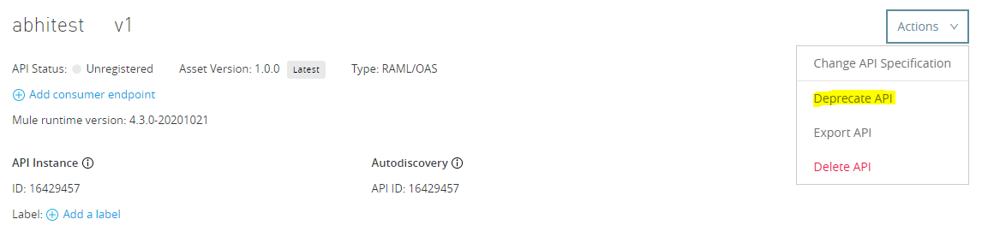
API Versioning
Each Exchange asset can have multiple asset versions - asset version follows the semantic format major.minor.patch format.
It is best practice to include the version number in the application URL: http://api.XX.com/v1/api/customer/1234
Run multiple versions of the application via different application endpoint and Exchange assets
For best practice on API Versioning, please refer to the following Mule documentation: https://docs.mulesoft.com/exchange/to-change-raml-version
Deprecation of APIs
An API is deprecated or disuse due to different reasons such as being replaced by an updated/newer version, diminished usage over time, etc.
Sometimes an old version of an API is deprecated instead of deprecating the whole API
It is recommended to communicate with the API consumers about the API deprecation and provide a detail documentation in Anypoint Exchange about an alternative or new way of connecting with the API to eliminate disruption
Provide an enough sunset period (2-3 months) as it provides the API consumers to adapt to the changes
Steps to initiate API deprecation in MuleSoft Anypoint Platform
At first, click on API Manager
Under API Administration section, click on the specific API instance which needs to be deprecated
Click on the “Deprecate API” option from Action dropdown
PwC | Sandy Spring Bank
8

Slide 9
Monitoring Anypoint Platform
Cloudhub API & Access Management API allow to access some of the functions of MuleSoft:
Manage applications : Create, deploy, start, stop, list, and delete an application on CloudHub
Retrieve statistics for an application or worker
Download the log file for an application or instance
Manage logs including app logs as well as audit logs, notifications, and alerts
Manage load balancers
User & Client Management
Roles and Permissions
Environments set up
For accessing the CloudHub API, at first Access Management API need to be used to authenticate with the Anypoint platform
The Cloudhub API enforces global usage limits i.e. 75 requests per second per client IP Address
Exchange documentation on Cloudhub API can be found here
Exchange documentation on Access Management API can be found here
PwC | Sandy Spring Bank
9

